Slide 1


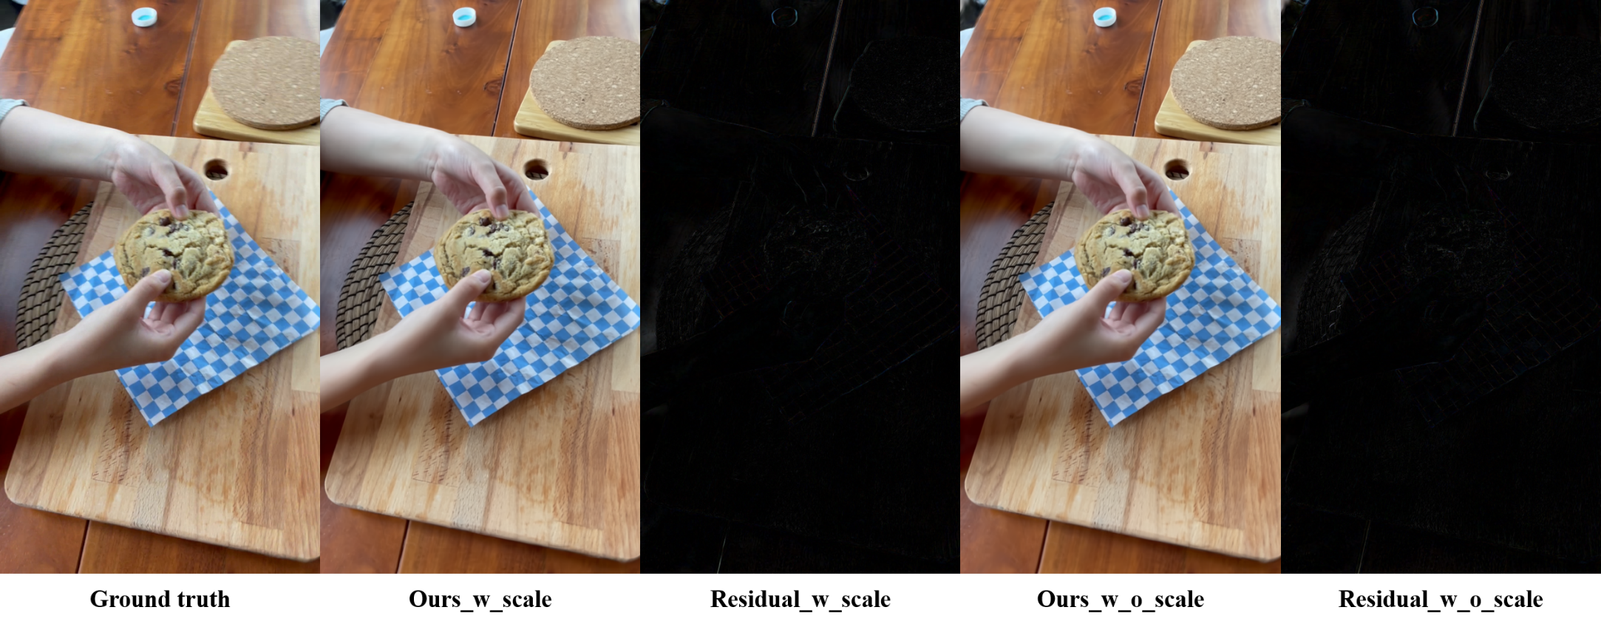
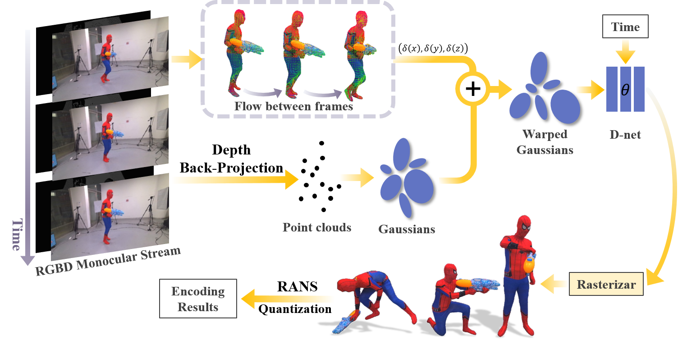
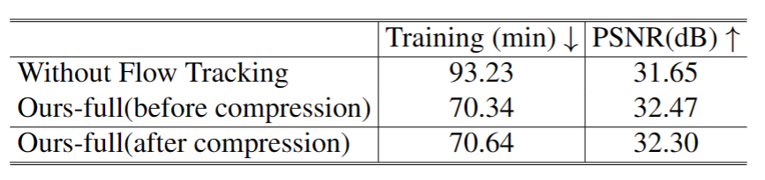
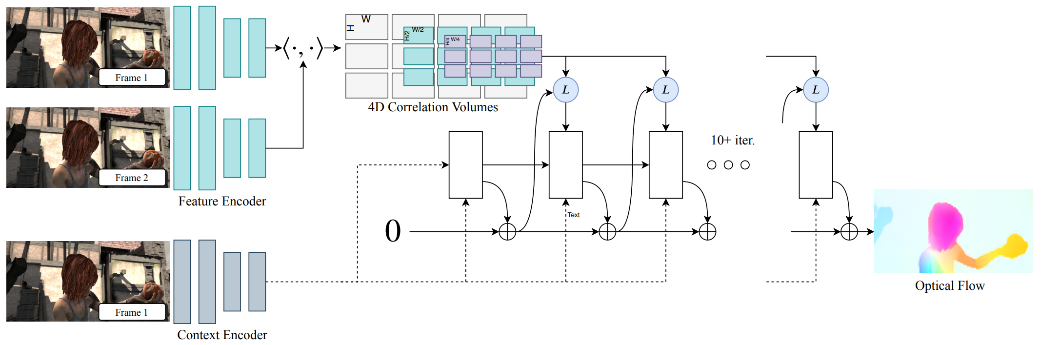
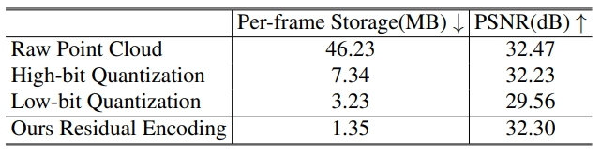
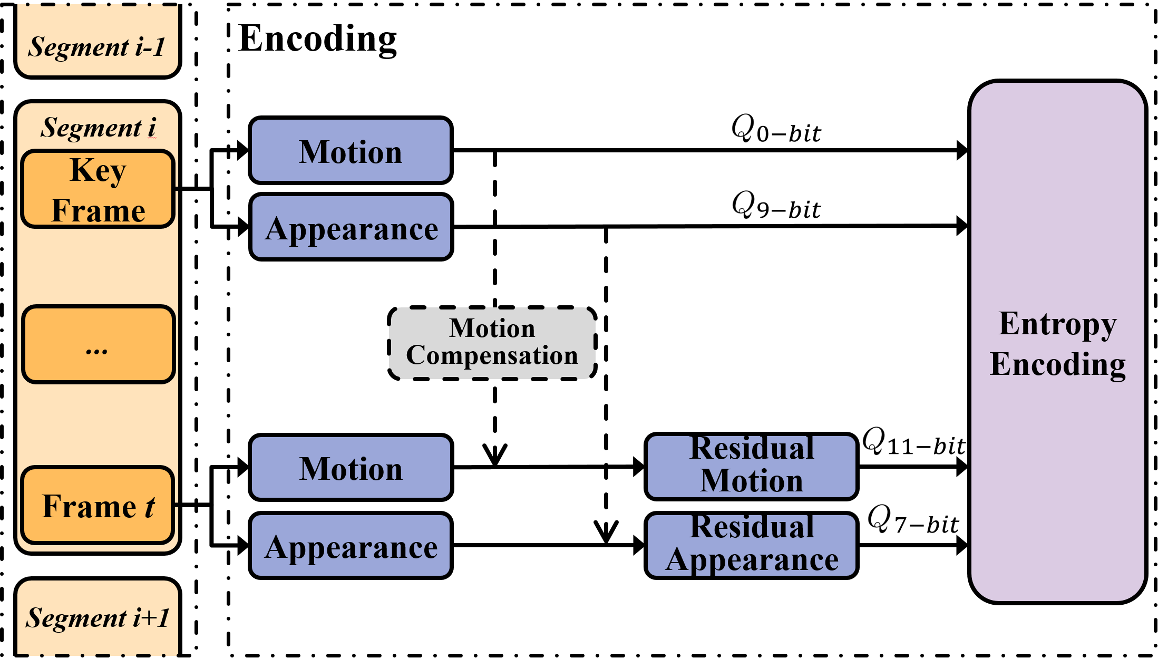
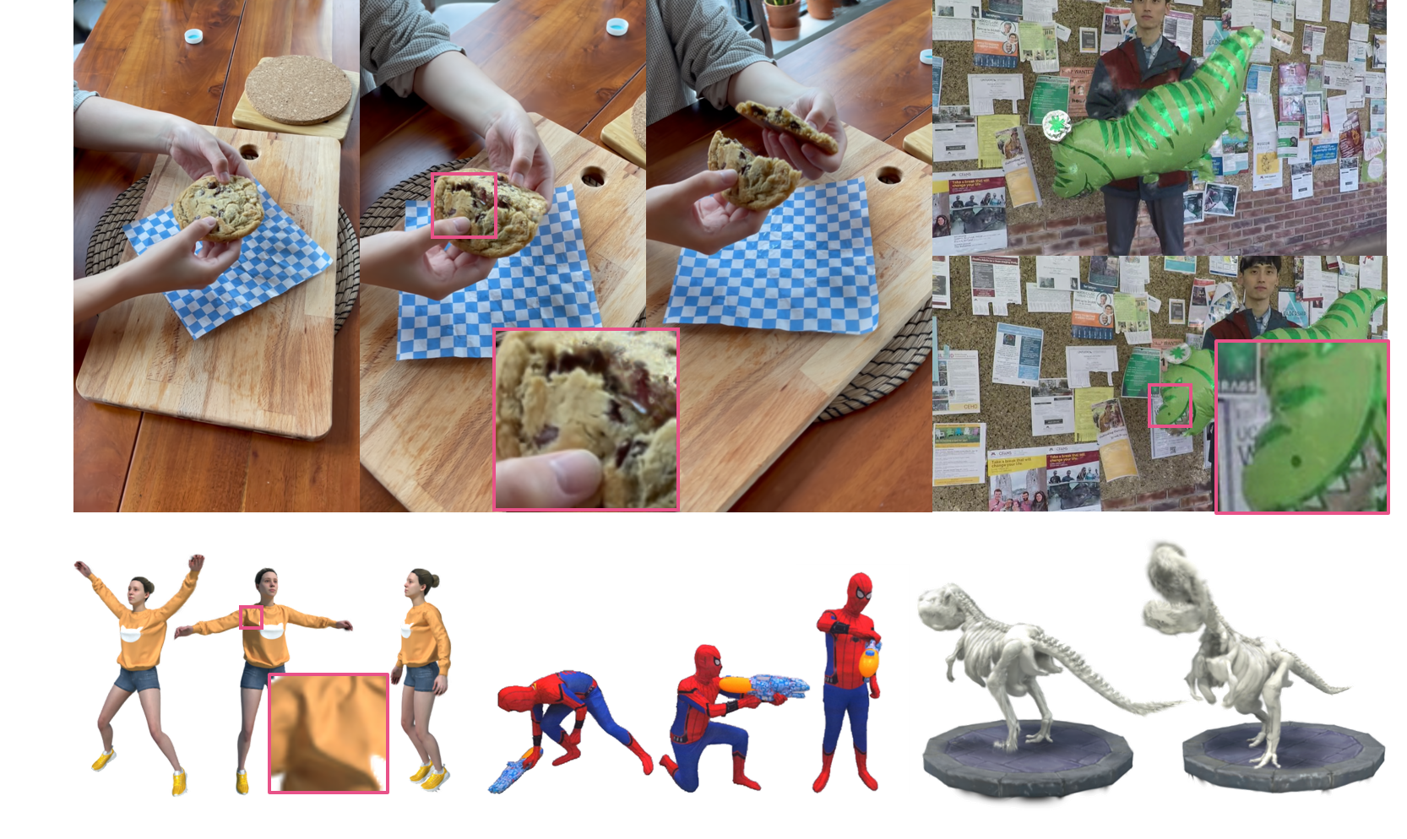
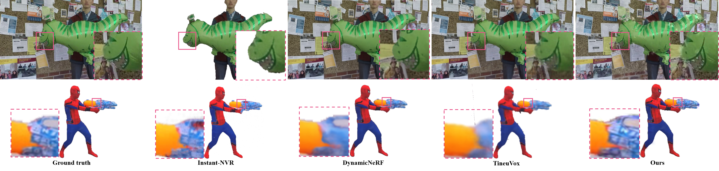
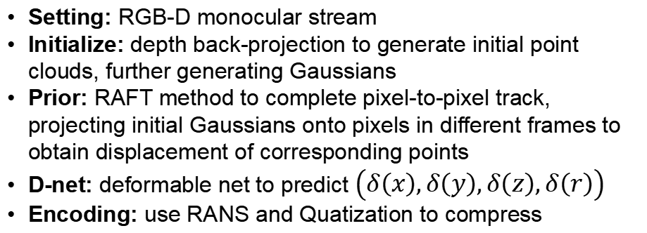
DynTCG: Dynamic View Synthesis from Monocular RGBD Streams via Flow-Tracked Compact Gaussians
Zhehao Shen¹ Penghao Wang¹ Yu Hong¹
Zhirui Zhang¹ Shouchen Zhou¹
Contributions
¹ShanghaiTech University
We propose a deformable Gaussian representation based on monocular RGBD input, aimed at accomplishing the task of dynamic novel view synthesis.
Utilizing optical flow tracking from 2D images, we provide an optimized initialization for the dynamic Gaussian deform field, significantly accelerating the training speed and enhancing the rendering quality under a monocular setting.
We showcase a companion compression scheme, supporting high quality rendering with low storage, even under various platforms..
Ablation: Scale
In the Gaussian parameters (rotation, position, scaling) for shape and position, we found that optimizing the scaling parameter didn't notably improve rendering but increased training time. Consequently, in designing our deform-net, we omitted optimizing the Gaussian scaling.
Results from training with and without scaling indicate a 9% time difference (with scale: 102 min, without scale: 93 min).
Pipeline
Ablation: Tracking
Setting: RGB-D monocular stream
Initialize: depth back-projection to generate initial point clouds, further generating Gaussians
Prior: RAFT method to complete pixel-to-pixel track, projecting initial Gaussians onto pixels in different frames to obtain displacement of corresponding points
D-net: deformable net to predict $\left(δ\left(x\right),δ\left(y\right),δ\left(z\right),δ\left(r\right)\right)$
Encoding: use RANS and Quatization to compress
Without Flow Tracking: directly use deform net to construct deformable gaussians
Ours-full: preprocess images to get flow between frames. Utilizing depth and optical flow as an effective initialization strategy for the deform net, aiming to expedite the optimization process.
Component: Optical Flow Tracking
Ablation: Compression
We employ RAFT as our method for optical flow tracking. RAFT comprises a Feature Extractor, Context Extractor, Visual Similarity Calculator, and Updater to optimize the flow tracking process.
Feature Extractor & Context Extractor: extract features from two images, followed by the extraction of semantic information from one of the images.
Visual Similarity Calculator: constructs a 4D correlation volume by calculating the dot product between feature vectors.
Updater: updates and refines flow tracking by iteratively searching the correlation volume based on current optical flow estimates.
Raw: directly saved per-frame gaussian point cloud
High-bit Quantization: 11-bit quantization on the point cloud
Low-bit Quantization: 9-bit quantization on the point cloud
Ours: compute the residual between the current frame and the previous frame, and then adopt 9-bit quantization and RANS encodig on the residual data
Results
HyperNeRF (top-left): pinhole camera, using depth estimation method from Dynamic View Synthesis from Dynamic Monocular Video
Dynamic Scene Dataset (top-right): hand-held monocular camcera, short-term dynamic events (~5 seconds)
D-NeRF (bottom-left and bottom-right): a sparse set of images of a dynamic scene
Instant-NVR (center bottom): RGB-D Kinect camera
Component: Residual Compression
Residual: compute residual point cloud data for smaller numerical range
Quantization: numerical quantization to delta point cloud and low bit on SH attribute for low storage
RANS Encoding: entropy encoding to efficiently compress the data
Comparison

